Slide 1

VISUALIZATION 101
Simi TALKAR Last modified on: Sept 4th, 2023

Slide 2

VISUALIZATION 101
Why should you care? NO One is paid to explore,
they are paiD to find
Simi TALKAR Last modified on: Sept 4th, 2023

Slide 3
Agenda
Design for your audience
Choose to display metrics based on why they matter.
Make sure your KPIs are relevant to the organization’s objectives.
Context is KING 👑
Expressiveness and Effectiveness (Gestalt), Technique (Mackinlay)
Who doesn’t love a checklist?
Tufte and Dashboard principles with examples

Slide 4
How Familiar are you with these Power BI Features and tools
Sorting and Sort Axis
Field Parameters and their capabilities.
Calculation Groups and Tabular Editor.
Slicer Panel and Bookmarks
Hierarchical slicers

Slide 5
REPORT CHECKLIST: Expand with Experience
Power BI Report Checklist — DATA GOBLINS (data-goblins.com)
Layout & Design
Use company color palette and theme JSON. This will set colors, font and titles for consistency
Add a title/summary page and / or appendix/ FAQ etc.
Label report objects clearly and consistently i.e. in selection pane
Accessibility
Set visual layer order and tab order
View and test the report on different screens, browsers and contexts.
Check accessibility of contrast, colors and fonts
Set default sort on visuals
Set chart axes to start at 0 (unless explicitly not desired)

Slide 6
REPORT CHECKLIST: Expand with Experience
Power BI Report Checklist — DATA GOBLINS (data-goblins.com)
Testing & Performance
Set and test all interactions
Test the report with a variety of filter combinations.
Eliminate unnecessary visuals
User Experience
Add links for users to report issues and submit requests/ideas
Synchronize slicers where necessary
Set interactions between visuals
Document testing cases, queries , methods and results
Test report performance with performance analyzer

Slide 7

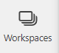
REPORT Training CHECKLIST
Give report walkthrough
Demonstrate questions answered by visuals
Reset to default
Subscribe and use subscriptions
Drill down and up
Buttons
Request access in AAD group
Filter pane
Cross-filtering and cross highlighting
Slicers
Comments
Drill through
Show as table
Personal bookmarks
Power BI Report Checklist — DATA GOBLINS (data-goblins.com)
Features
Benefits

Slide 8

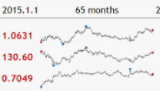

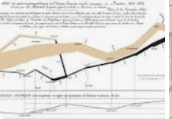
NAME DROPPING MENtIMETER
Converting domain to visualization
1
2
3
4

Slide 9
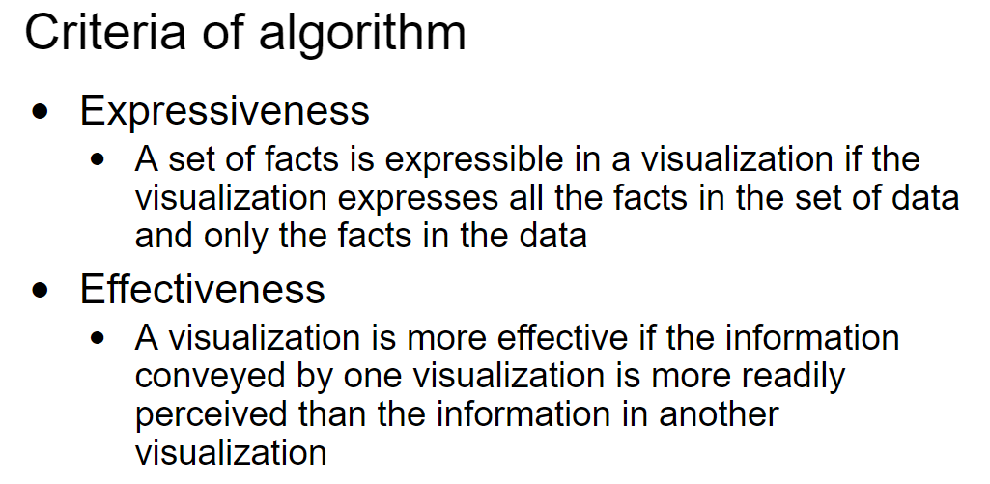
📊 ACTIONABLE INSIGHTS THROUGH QUANTIFIABLY EFFECTIVE VISUALIZATIONS

Slide 10
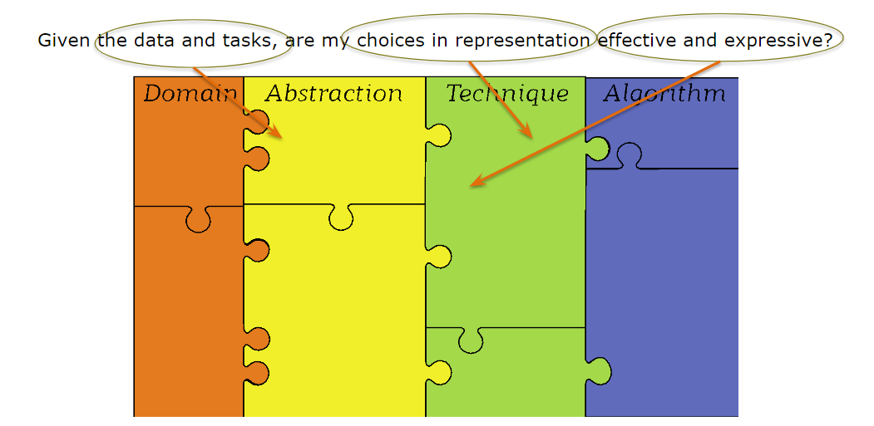
ASK

Slide 11
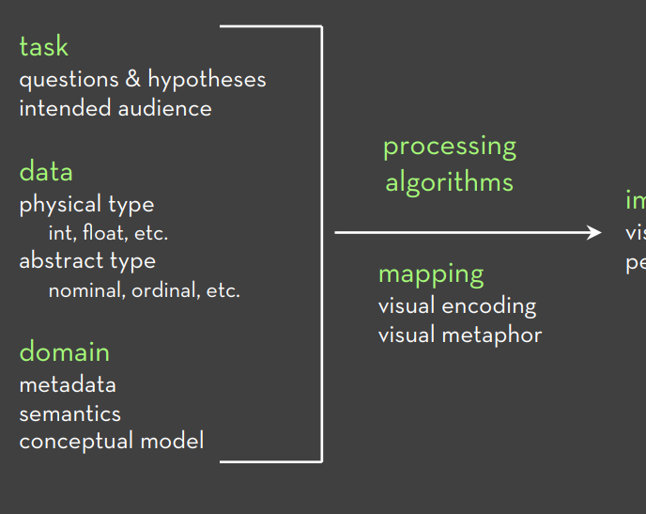
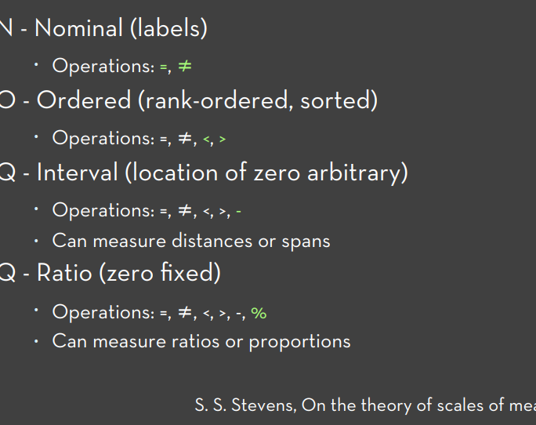
The BIG PICTURE
Converting domain to visualization

Slide 12
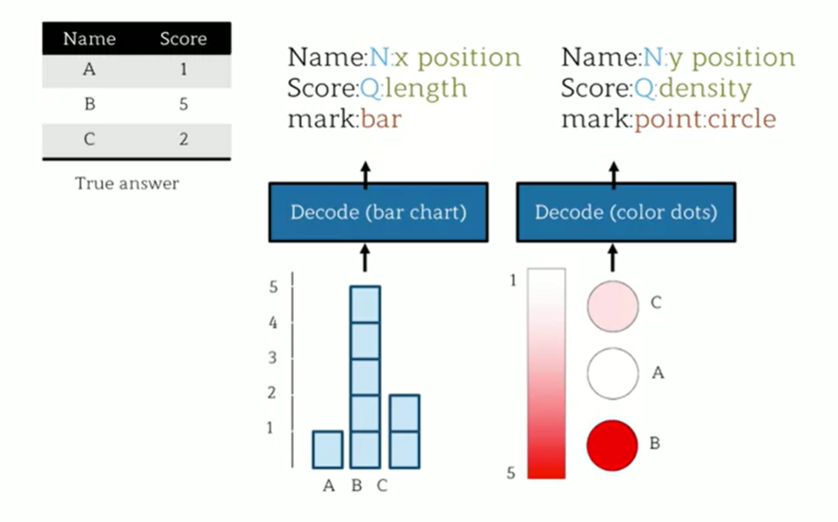
EXPRESSIVE : DECODE WHAT WAS ENCODED

Slide 13
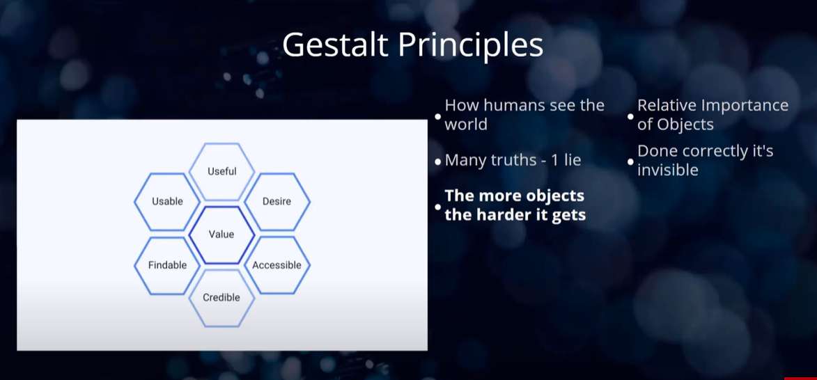

EFFECTIVENESS ‘GESTALT PSYCHOLOGY’ The simplest and most stable interpretations are the ones that are favored

Slide 14
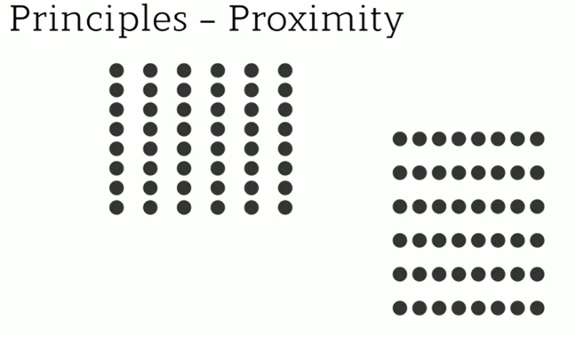
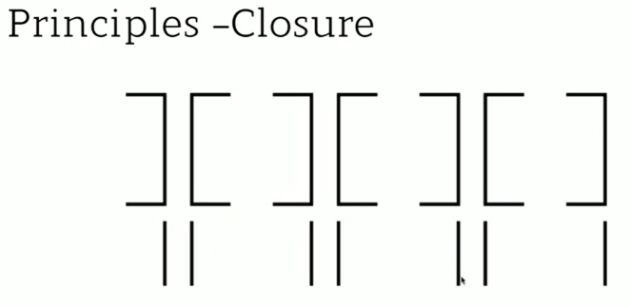

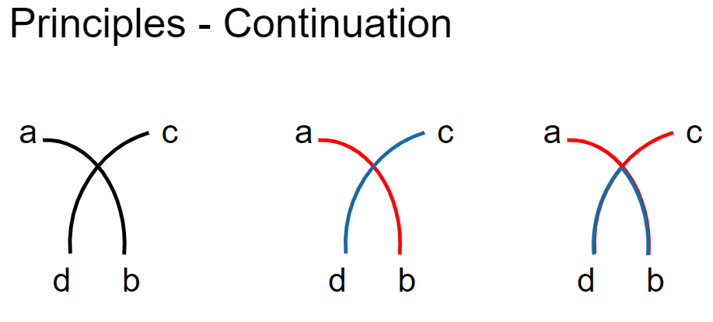
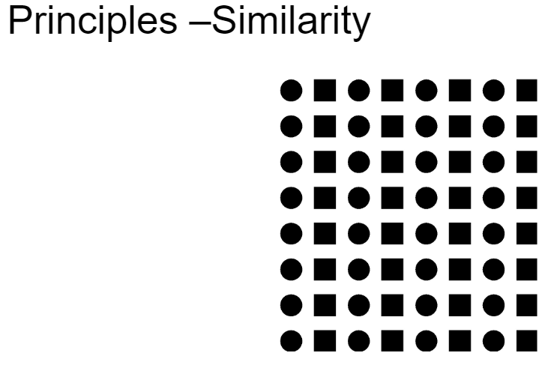
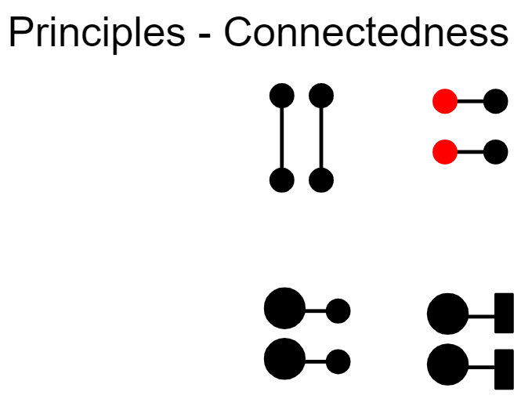

EFFECTIVENESS ‘GESTALT PSYCHOLOGY’ The simplest and most stable interpretations are the ones that are favored

Slide 15
EFFECTIVENESS ‘GESTALT PSYCHOLOGY’ The simplest and most stable interpretations are the ones that are favored
Proximity: When we see multiple elements located near one another, we tend to see them as a group. For example, we can visually distinguish clusters in a scatter plot by grouping the dots according to their position.
Similarity: Our brain associates elements that are similar to each other (shape, size, color, or orientation). For example, consider a chart with color encoding. Even if they are not grouped, we can associate the bars that share the same color.
Enclosure: If a border surrounds a series of objects, we perceive them as a group. For example, if a scatter plot has two reference lines that wrap the elements between 20 and 30 percent, we automatically see them as a cluster.
Closure: When we detect a figure that looks incomplete, we tend to perceive it as a closed structure. For example, even if we discarded the borders of a bar chart, the axes would form a region that our brain isolates without the need of extra lines.
Continuity: If a number of objects are aligned, we usually perceive them as a continuum. For instance, consider the notion of different blocks of code when you indent a script.
Connection: If a set of objects are connected by a line, we also see them as a group. For example, a scatter plot with lines and symbols (dots connected by lines).

Slide 16
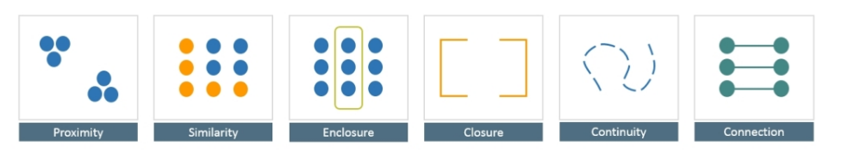
EFFECTIVENESS ‘GESTALT PSYCHOLOGY’ The simplest and most stable interpretations are the ones that are favored

Slide 17
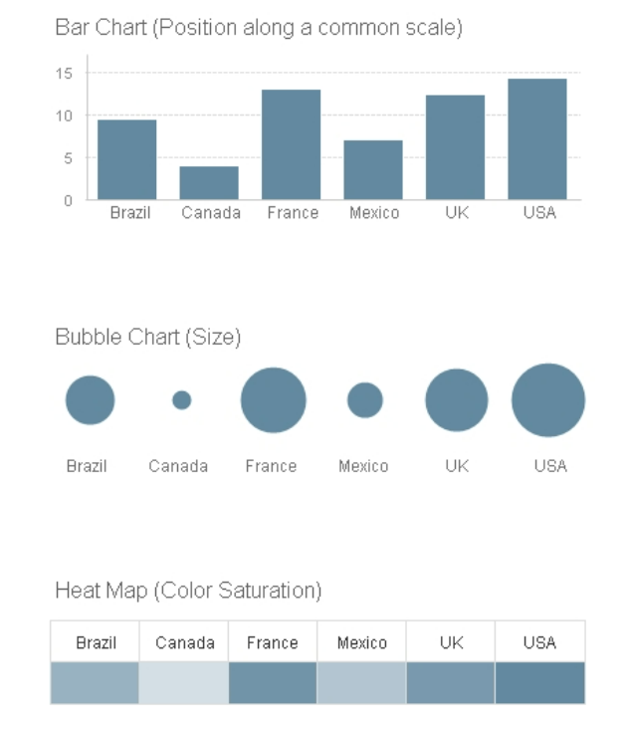
EFFECTIVENESS

Slide 18

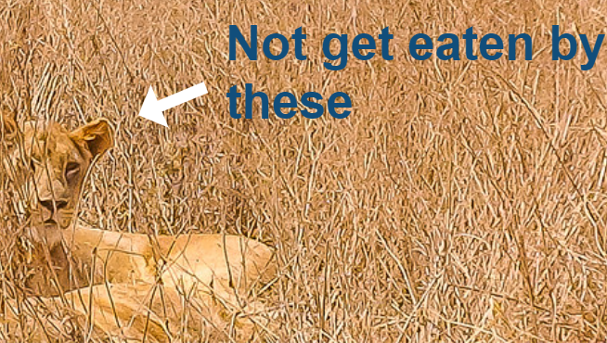
TECHNIQUES DEVELOPED FROM EMPERICAL DATA ON VISUAL PERCEPTION
FIND THESE

Slide 19
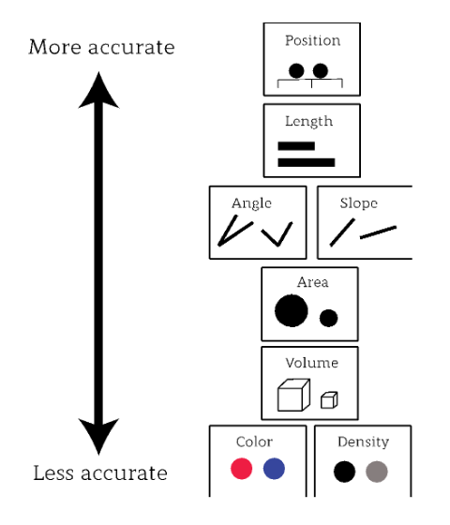
Mackinlay – A presentation TOOL

Slide 20
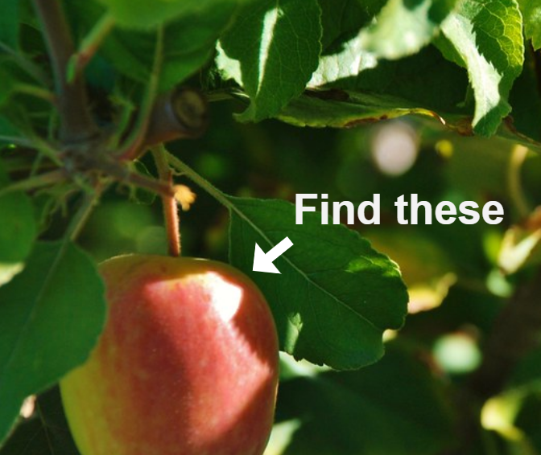
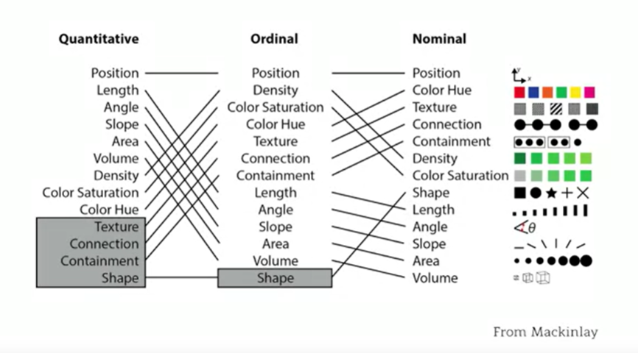
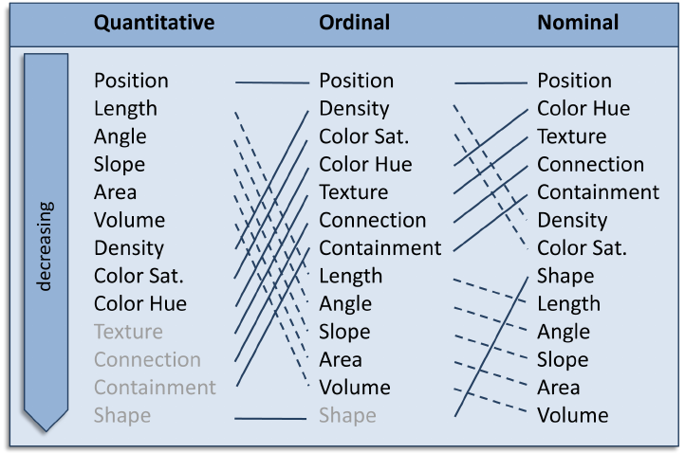
EMPERICAL DATA ON VISUAL PERCEPTION

Slide 21
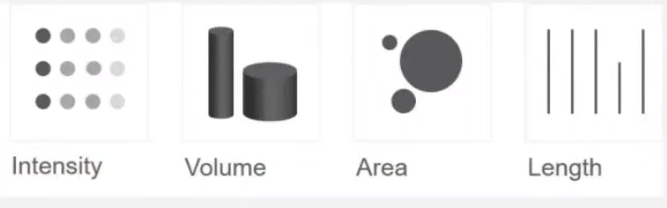
Mackinlay – (WARM UP not mentimeter)
Which Visual helps us perceive most accurately the difference in value 120 and 100?
1
2
3
4

Slide 22
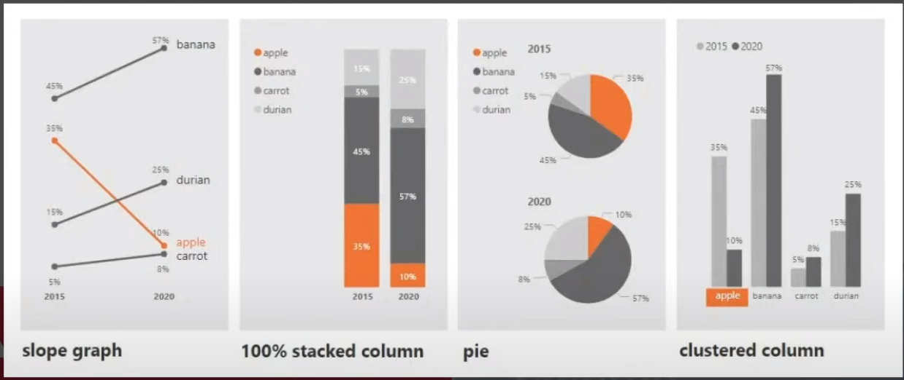
Mackinlay – MENTIMETER
Which Visual helps us perceive most accurately the change in magnitude of product likeability magnitude from 2015 to 2020?
1
2
3
4

Slide 23
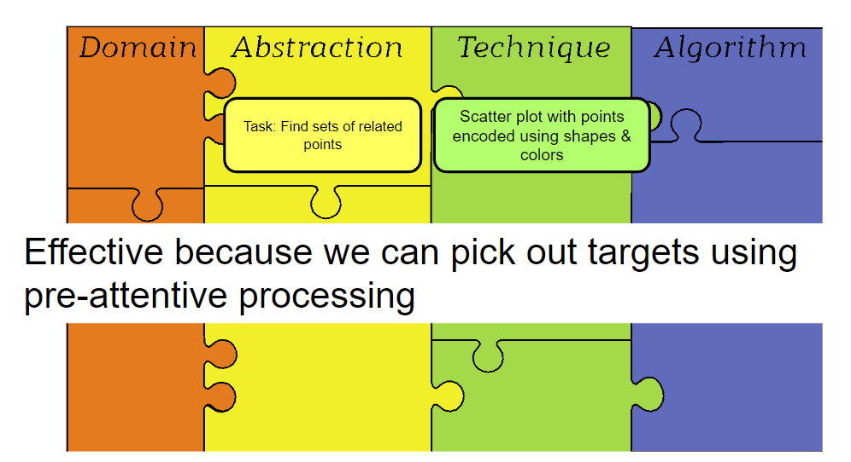
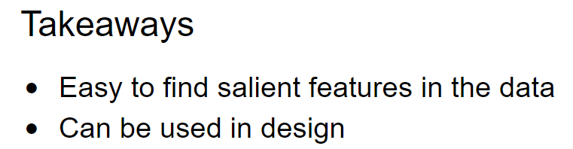
ASK

Slide 24
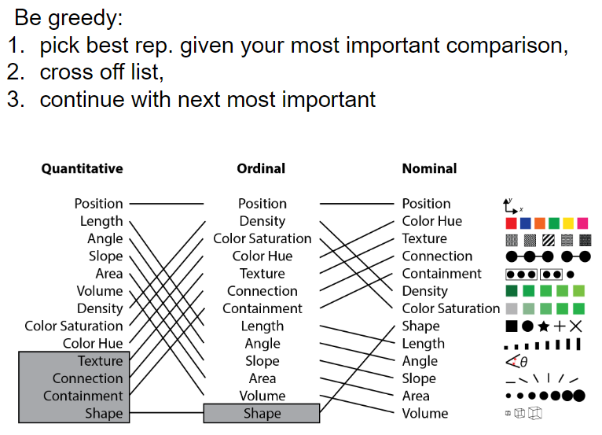
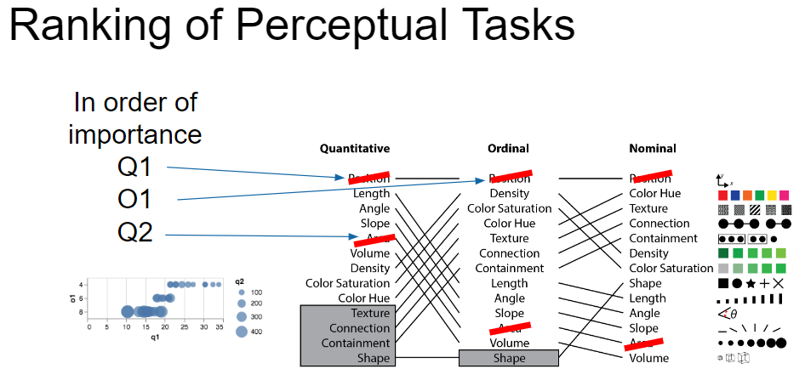
IMPLEMENT

Slide 25
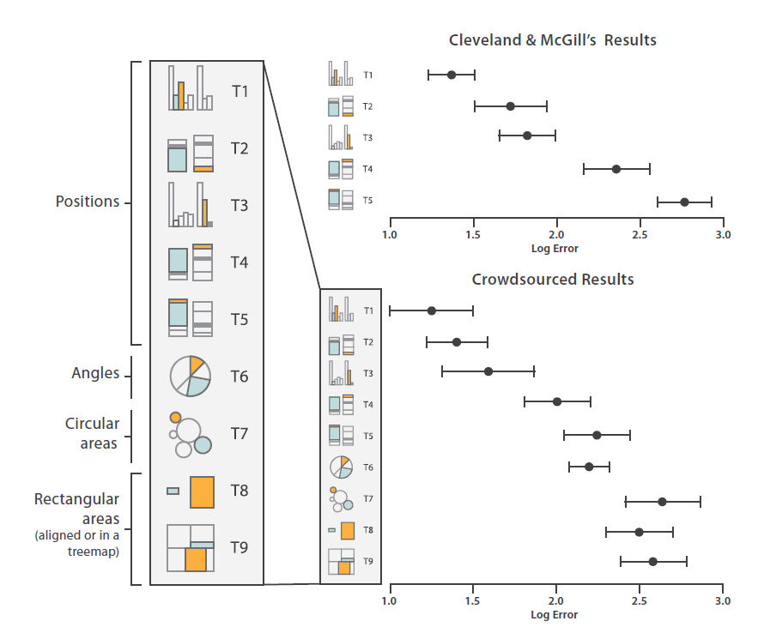
EMPIRICAL EVIDENCE

Slide 26
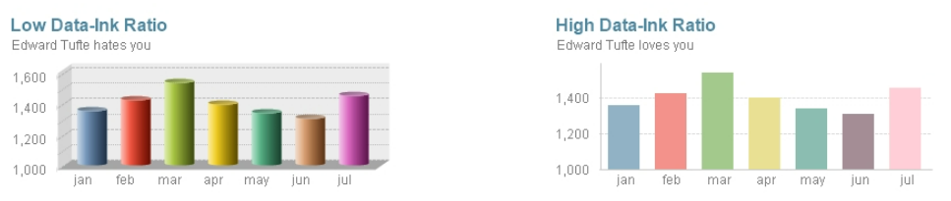
DATA INK RATIO
A core principle introduced by Edward R. Tufte in his book, The Visual Display of Quantitative Information.
Data-Ink: This includes all the nonerasable portions of the graphic that are used to represent the actual data. These pixels are the core of the visualization and cannot be removed without losing some of its content.
Non-Data-Ink: This includes any other elements that's not directly related to the data or that don't convey anything meaningful to the reader.
Defined as the proportion of a graphic's ink devoted to the nonredundant display of information
Data Ink Ratio = Data Ink / Total Ink 🔼
Portfolio — Darkhorse Analytics | Edmonton, AB

Slide 27
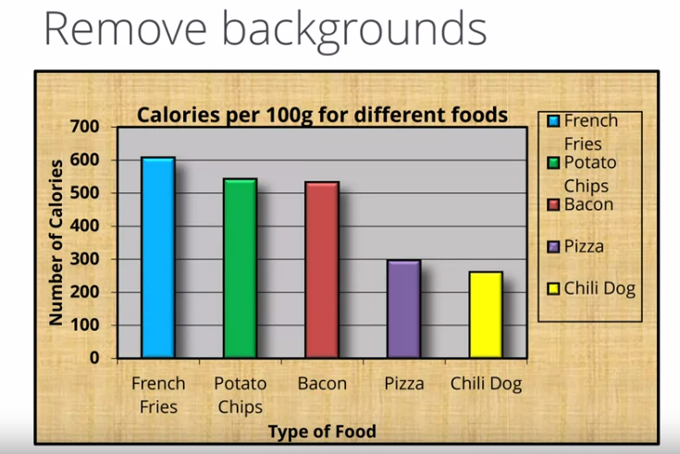
DATA INK RATIO

Slide 28

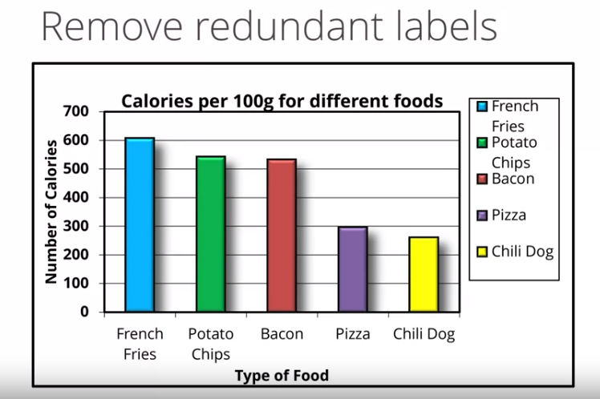
DATA INK RATIO
Series Labels

Slide 29
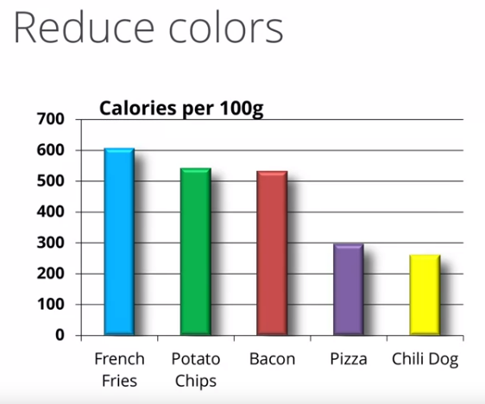
DATA INK RATIO

Slide 30
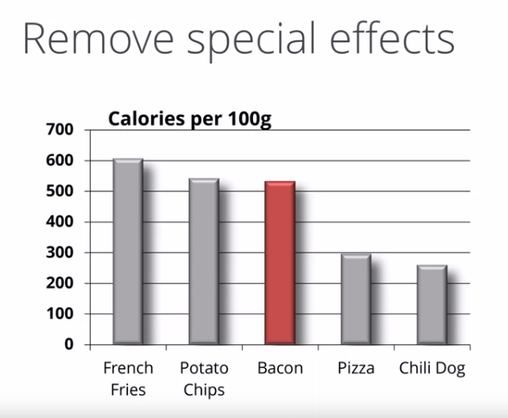
DATA INK RATIO
Emphasize

Slide 31
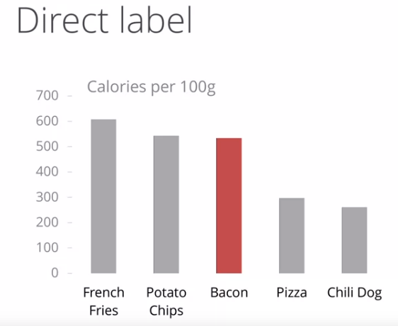
DATA INK RATIO
Emphasize

Slide 32
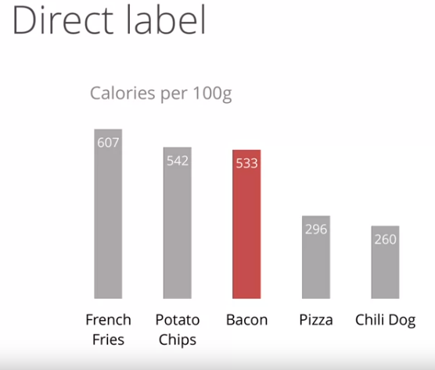
DATA INK RATIO
Emphasize

Slide 33
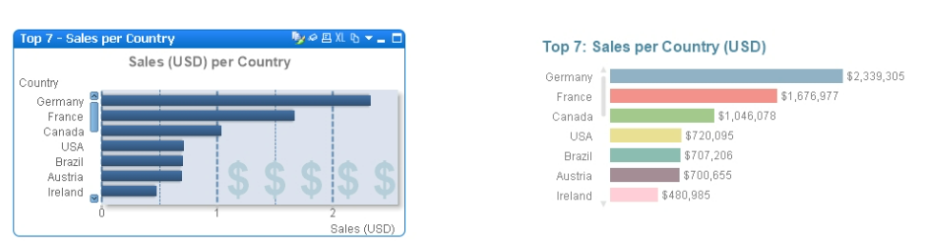
CHART JUNK
Refers to all the elements that distract the viewer from the actual information in a graphic.
🚫
Heavy gridlines
Frames
Redundant labels
Ornamental axes
Backgrounds
Overly complex fonts
Shadows
Images
or other effects included only as decoration.

Slide 34
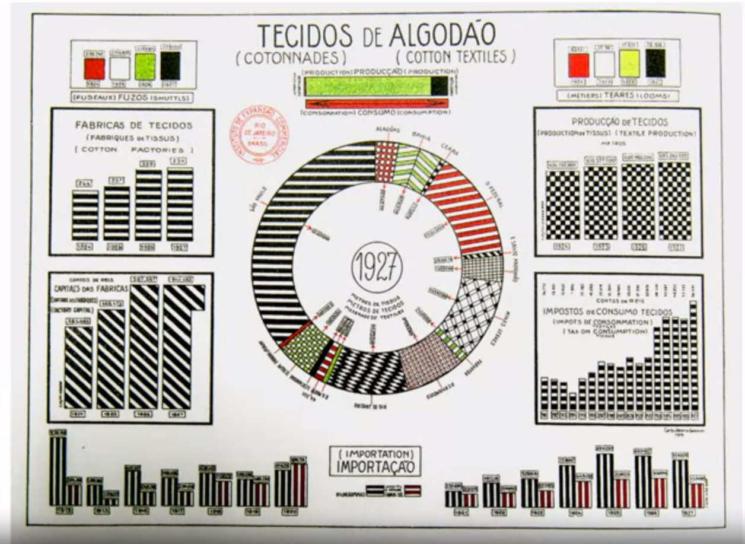
Chart Junk : Remove Patterns AND GRIDS

Slide 35
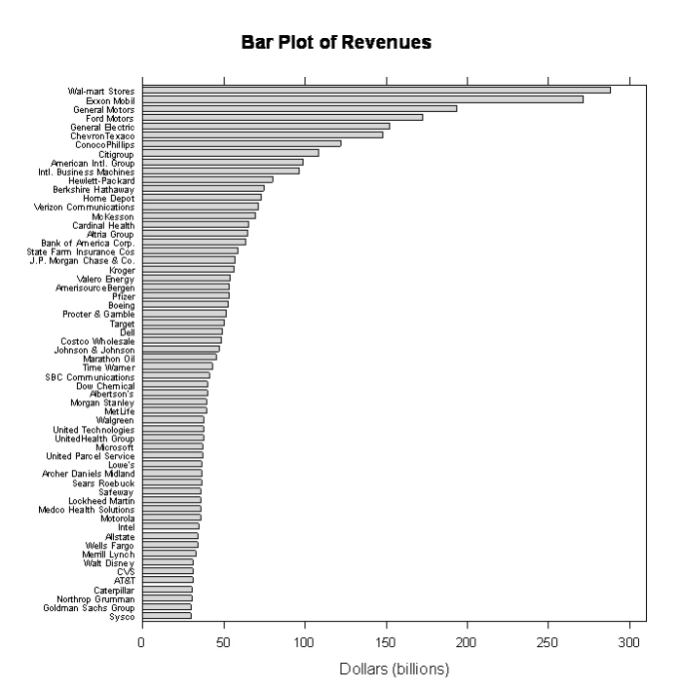
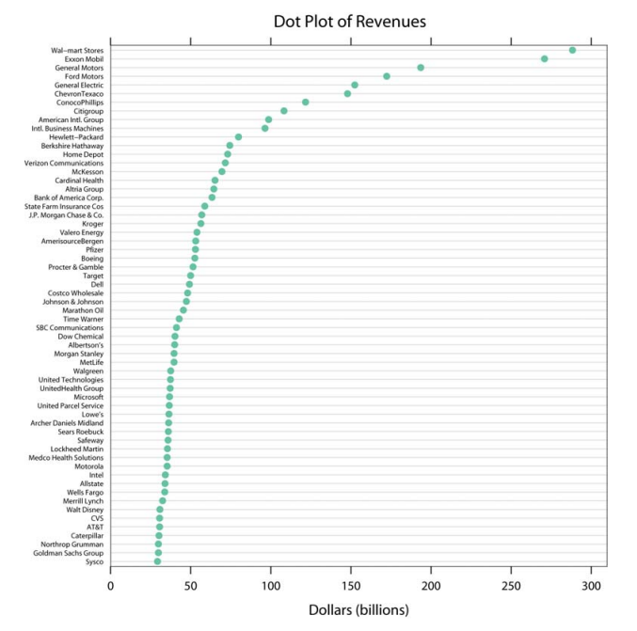
CHART JUNK
Refers to all the elements that distract the viewer from the actual information in a graphic.
Lollipop Chart

Slide 36
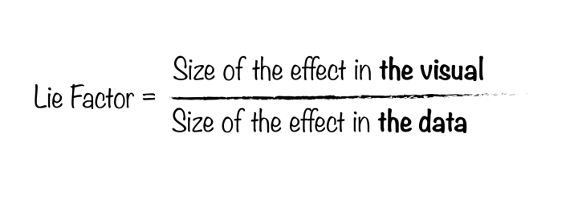
LIE FACTOR
Bar Chart

Slide 37
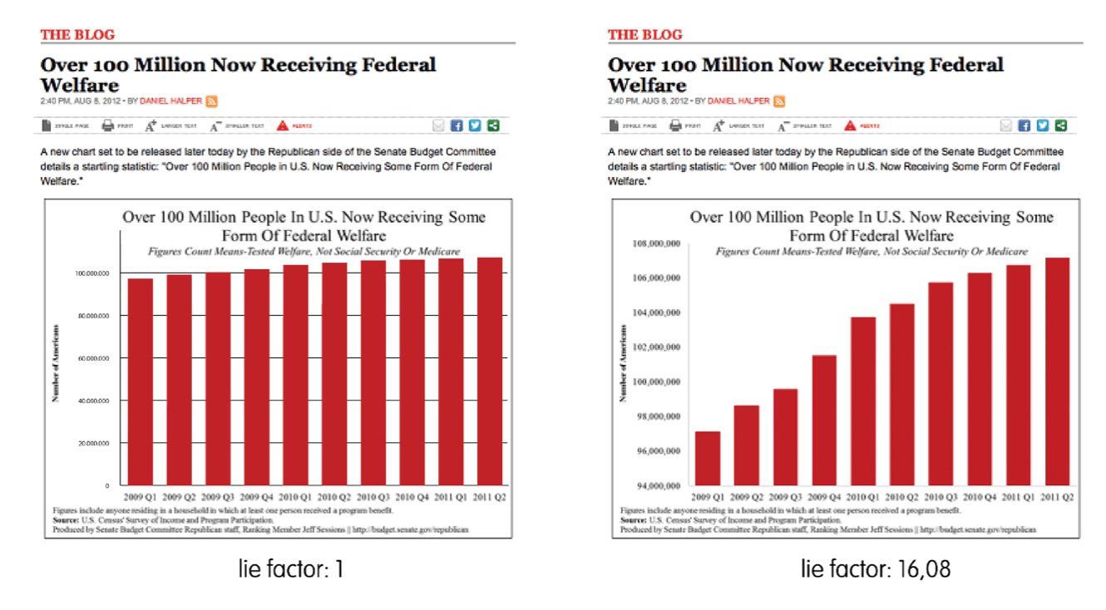
LIE FACTOR
Bar Chart

Slide 38
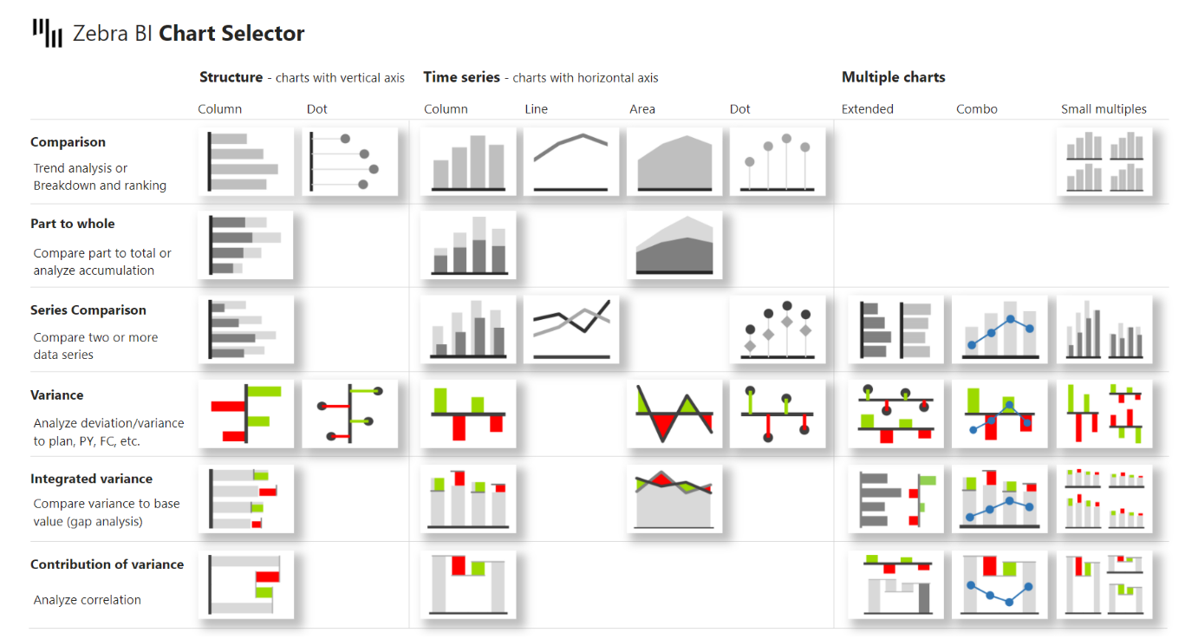
CHART SELECTOR

Slide 39
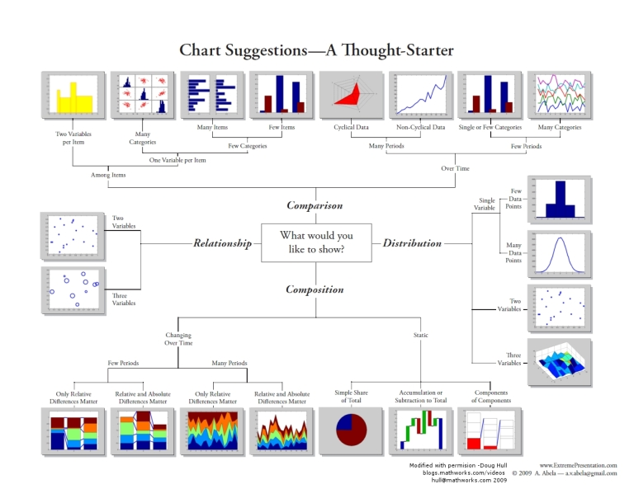
CHART SELECTOR

Slide 40
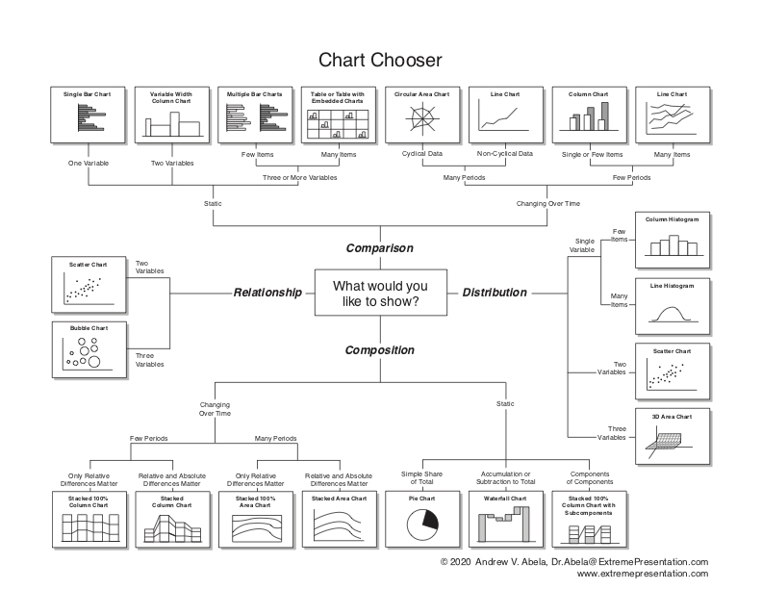
CHART SELECTOR
Choosing a good chart - The Extreme Presentation(tm) Method (typepad.com)

Slide 41
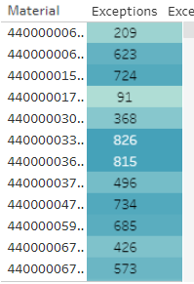
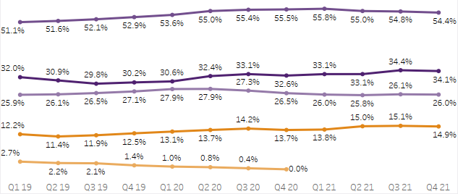
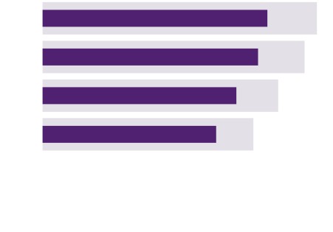
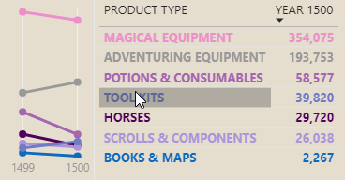
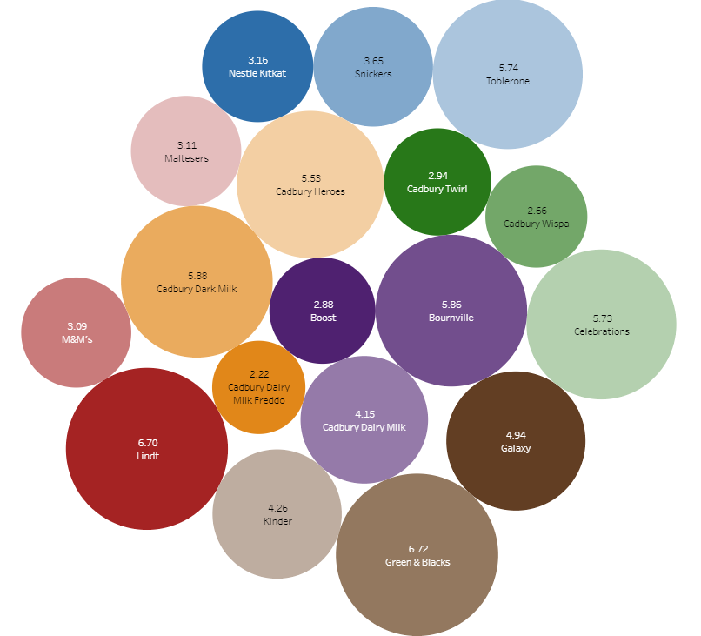
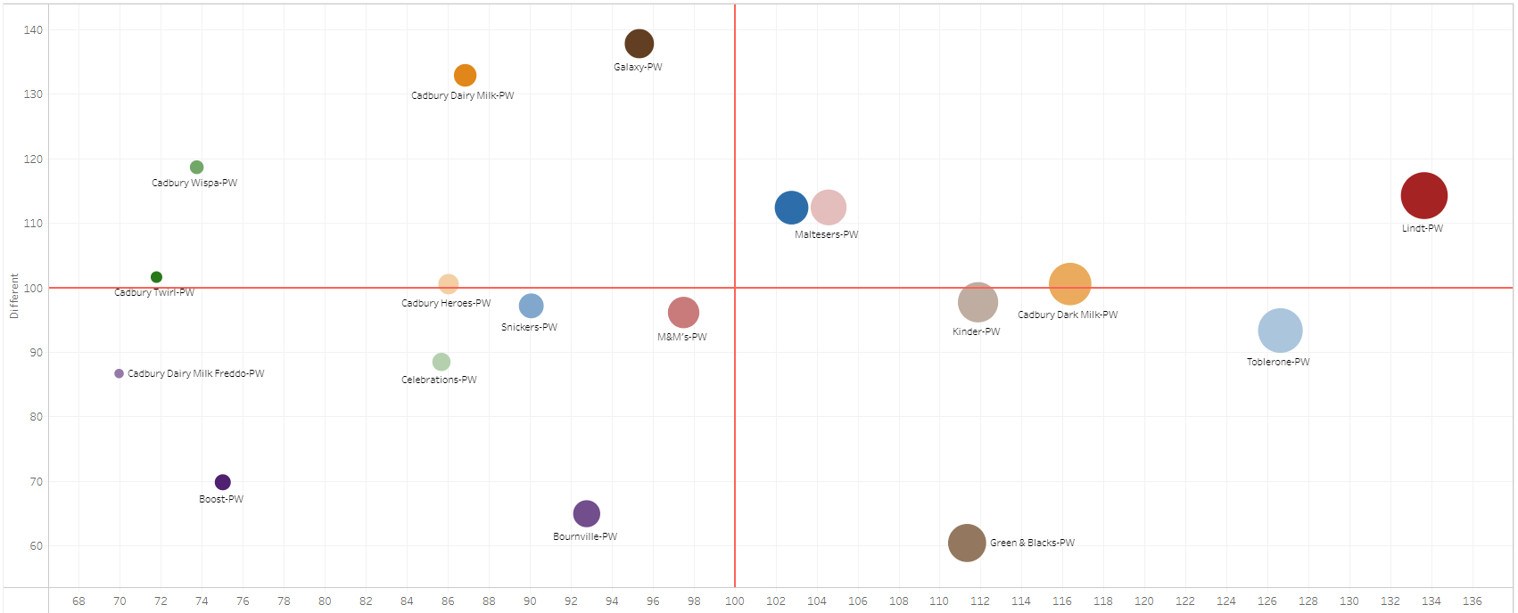
Visualizations – TYPICAL AND EFFECTIVE
Visualizations
Guidelines for choosing visualizations types
Bar Chart
Line Chart
Heat Map
Ideal:
Comparing data across categories
Difference between categories
Single Variable Distributions (histogram)
Non-Ideal:
Show data over time
Ideal:
Time-Series for non-cyclical data
Identifying trends
Multiple categories over time
Non-Ideal:
Distributions
Relationships
Composition
Ideal:
Relationship
Multivariate Analysis
Distribution
Non-Ideal:
Proportions
Comparisons across more than 2 categories
Example Use: Sales across regions, volume of sales, spend across categories, comparing previous year data
Example Use: Sales over time, market growth, forecasting, revenue trends
Example Use: Segment analysis, product sales across regions, sales across brands
Slope graph
Scatterplot
Bubble Chart
The advantage of a slope is that you can show both the relative and absolute change across a dimension. This adds value to category comparisons because users can not only visually identify large relative changes, but focus on the larger absolute differences. Having multiple lines - one for each category - gives the user a lot of information expressed concisely in a single visual.
Ideal:
Distributions
Relationships
Correlations
Non-Ideal:
Comparing qualitative data
Categorization
Composition
Ideal:
Relationship between 3 variables
Overlay on maps
Non-Ideal:
Comparing across categories
Proportions
Compositions
Example Use: year-over-year or month-over-month. Also can be used as a KPI
Example Use: Concentration analysis, sales patterns, cost analysis, outlier identification, trends, identifying lagging products
Example Use: Sales concentration, product comparisons, Sales across regions, product comparisons

Slide 42

Visualizations – EXISTING Recommendations
Visualizations
Guidelines for choosing visualizations types
Bar Chart
Line Chart
Heat Map
Ideal:
Comparing data across categories
Difference between categories
Single Variable Distributions (histogram)
Non-Ideal:
Show data over time
Ideal:
Time-Series for non-cyclical data
Identifying trends
Multiple categories over time
Non-Ideal:
Distributions
Relationships
Composition
Ideal:
Relationship
Multivariate Analysis
Distribution
Non-Ideal:
Proportions
Comparisons across more than 2 categories
Example Use: Sales across regions, volume of sales, spend across categories, comparing previous year data
Example Use: Sales over time, market growth, forecasting, revenue trends
Example Use: Segment analysis, product sales across regions, sales across brands
Tree Map
Scatterplot
Bubble Chart
Ideal:
Proportions
Compositions
Hierarchal Data
Non-Ideal:
High # categories
Relationships
Ideal:
Distributions
Relationships
Correlations
Non-Ideal:
Comparing qualitative data
Categorization
Composition
Ideal:
Relationship between 3 variables
Overlay on maps
Non-Ideal:
Comparing across categories
Proportions
Compositions
Example Use: Market share, product sales breakdown, region comparisons. Top 5 vs Bottom 5, comparing budget across years
Example Use: Concentration analysis, sales patterns, cost analysis, outlier identification, trends, identifying lagging products
Example Use: Sales concentration, product comparisons, Sales across regions, product comparisons

Slide 43
Design BEST PRACTICES SUMMARY
1
Annotate and Highlight areas to draw the viewer’s attention to what you want them to learn, annotate.
Create sparse visuals so that the information to be conveyed stand out. This can be done by using muted colors if there are many data points and you want to highlight one in reference to the others.
Use the same color across a certain feature. In other words, be consistent in the usage of positive and negative tones or say Shipped is always purple and Planned is always orange. This reduces movement of eye to legend repeatedly.
Apply the principle of how the eye moves for the placement of the visuals. Ideal flow is left to right and top to bottom.
When using interactivity, set defaults to the one that should most likely be of interest to the user.
Derive the conclusion out and then decide how to present it. Smarter narratives can make this dynamic.
Normalize the data and create log scales to compare features of two very different dimensions on the same axis.
2
3
4
5
6
7

Slide 44
Best Practices : Arrangement and placement
And you will read this last
You will read this first
And then you will read this
Then this one

Slide 45



Best Practices : CONTEXT IS KING
Design for your audience.
Learn from Stakeholders WHY a KPI Matters and “how relevant they are to the organization’s objectives.”(EI)
Keep the dashboard simple and intuitive – a picture should be worth 1,000 words!
Limit your visuals to 3-5 per dashboard (EI)
Provide Context Create charts relative to a target and origin (0,0)
Highlight the time period of report preferably on menu bar. Display last refesh time.
A dashboard is a visual display of the most important information needed to achieve one or more objectives; consolidated and arranged on a single screen so the information can be monitored at a glance.

Slide 46
DASHBOARD Design BEST PRACTICES IN POWER BI
Dashboard Elements
“Data graphics should draw the viewer’s attention to the sense and substance of the data, not to something else. [Edward Tufte]
1
Remove Chart Junk
Axis labels in titles, Grid Lines and Data labels
Filters Move to Slicer Panel and print value on page
2
Multiply Visualizations
Field Parameters and Calculation groups (use Tabular Editor)
3
Annotate and show insights
Smart Narratives
Series Labels and data labels with leader lines
4
COLORS

Slide 47


QUICK WINS…..NO One is paid to explore, they are paiD to find 🔍
DASHBOARD Design BEST PRACTICES IN POWER BI
🗻SORTING
Whether you are working with a list box, a bar chart, or a straight table, sorting an object is always advisable as it adds context to the data. It can help you find the most commonly selected items in a list box, distinguish which element is bigger on a pie chart when the slices are similar, or easily spot the outliers in other graphic representations.

Slide 48
QUICK WINS…..NO One is paid to explore, they are paiD to find 🔍
DASHBOARD Design BEST PRACTICES IN POWER BI
🚫SCROLL BARS
Avoid scroll bars
Stephen Few (Perceptual Edge ) emphasizes that all the information in a dashboard must fit on a single screen. While I believe that there is no harm in splitting the data in multiple sheets, it is undeniable that scroll bars reduce the overall usability of an application. If the user has to continuously scroll right and left to read all the figures in a table, or if she must go up and down to see the filter panel, she will end up getting tired and eventually discard your dashboard.

Slide 49

QUICK WINS…..NO One is paid to explore, they are paiD to find 🔍
DASHBOARD Design BEST PRACTICES IN POWER BI
🎚 ALIGN

Slide 50

QUICK WINS…..NO One is paid to explore, they are paiD to find 🔍
DASHBOARD Design BEST PRACTICES IN POWER BI
Series Labels

Slide 51

Layout, Clutter and Flow (EI)
Utilize high view sections, minimize clutter and convey information for ideal flow
The most important/main KPI’s and visuals to the top-left or center
Ideal flow is left to right and top to bottom
Group global filters/legends together and individual filters/legend with respective visuals
Use consistent colors/layouts
Separate visually using borders
Keep tables and details towards the bottom/right
Main Emphasis
Flow
Flow

Slide 52


Visualizations – DRILLTHROUGH FOR DETAILS
DRILLTHROUGH
Visuals that are specific for the business analysis

Slide 53




Visualizations – MULTIPLY USING CALCULATION GROUPS
PARAMETERS
💍ONE GROUP TO RULE THEM ALL
X MATRIX
SELECTEDMEASURE()
CALCULATION ITEMS

Slide 54


Visualizations – OPTIONS USING FIELD PARAMETERS
PARAMETERS
💍ONE GROUP TO RULE THEM ALL
X AXIS | X VISUALS

Slide 55

Visualizations – OPTIONS USING FIELD PARAMETERS
PARAMETERS
💍ONE PARAMETER TO RULE THEM ALL

Slide 56

Tooltips
✨Enhance tips on hover using Tooltip report pages
Visualizations

Slide 57

FILTERS
Sample Slicer Panel

Slide 58

FILTERS
Sample Slicer Panel

Slide 59
Visualizations - Colors
Colors (for additional colors see Company / Corporate Guidance)
Use the theme
Be consistent
Use color sparingly
Discrete Color Sequence (Below) and Continuous Colors Sequences
Actuals – #4f2170 || Purple
PY Value- #DEDBE0 || Light grey
value – #7ff1f2 ||
Alert – #E18719 || Orange
Negative value (#a52323) || Red
Positive value (#287819) || Green

Slide 60
Company THEME Colors
Import Color Palette using company theme

Slide 61









Visualizations – example : WHAT MUST I FOCUS ON?................. !!!!?
#917865 #15AABA #4F2170 #957AA9 #EAAB5E #623E23
#E6AF23 #EE440F #4F2170 #917865 #2D6EAA #E18719
NO FOCUS
#2D6EAA #15AABA #4F2170 #EDC765 #AF93C3 #724E8D
# E6AF23 #A52323 #4F2170 # 917865 # 287819 # E18719

Slide 62

EFFECTIVE USE OF COLOR MENTIMETER

Slide 63

EFFECTIVE USE OF COLOR MENTIMETER
Refers to all the elements that distract the viewer from the actual information in a graphic.
HOW MANY 2s CAN YOU FIND?

Slide 64


#917865 #15AABA #4F2170 #957AA9 #EAAB5E #623E23
#E6AF23 #EE440F #4F2170 #917865 #2D6EAA #E18719
#2D6EAA #15AABA #4F2170 #EDC765 #AF93C3 #724E8D
# E6AF23 #A52323 #4F2170 # 917865 # 287819 # E18719

Slide 65

#917865 #15AABA #4F2170 #957AA9 #EAAB5E #623E23
#E6AF23 #EE440F #4F2170 #917865 #2D6EAA #E18719
#2D6EAA #15AABA #4F2170 #EDC765 #AF93C3 #724E8D
# E6AF23 #A52323 #4F2170 # 917865 # 287819 # E18719

Slide 66

you May NOT NEED COLOR AT ALL
#2D6EAA #15AABA #4F2170 #EDC765 #AF93C3 #724E8D
# E6AF23 #A52323 #4F2170 # 917865 # 287819 # E18719

Slide 67


RESOURCES FOR DESIGNNG FOR THE COLOR BLIND
Resources for Designing for the Colorblind - We are Colorblind
Around 1 in 12 men and 1 in 200 women have some form of color blindness. People with color blindness (also knows as Color Vision Deficiency) face daily usability and accessibility challenges with websites, webapps, webshops, and apps in their daily life.

Slide 68
REPORT CHECKLIST
Power BI Report Checklist — DATA GOBLINS (data-goblins.com)
Layout & Design
Use company wide color palette and theme JSON. This will set colors, font and titles for consistency
Add a title/summary page and / or appendix/ FAQ etc.
Label report objects clearly and consistently i.e. in selection pane
Accessibility
Set visual layer order and tab order
View and test the report on different screens, browsers and contexts.
Check accessibility of contrast, colors and fonts
Set default sort on visuals
Set chart axes to start at 0 (unless explicitly not desired)

Slide 69
REPORT CHECKLIST
Power BI Report Checklist — DATA GOBLINS (data-goblins.com)
Testing & Performance
Set and test all interactions
Test the report with a variety of filter combinations.
Eliminate unnecessary visuals
User Experience
Add links for users to report issues and submit requests/ideas
Synchronize slicers where necessary
Set interactions between visuals
Document testing cases, queries , methods and results
Test report performance with performance analyzer

Slide 70
REPORT Training CHECKLIST
Give report walkthrough
Demonstrate questions answered by visuals
Reset to default
Subscribe and use subscriptions
Drill down and up
Buttons
Request access in AAD group
Filter pane
Cross-filtering and cross highlighting
Slicers
Comments
Drill through
Show as table
Personal bookmarks
Power BI Report Checklist — DATA GOBLINS (data-goblins.com)
Features
Benefits

Slide 71
Logos & Icons
Common images used in the Dashboards : Use as designed by company

Slide 72
Summary
“Perfection is achieved, not when there is nothing more to add,
but when there is nothing left to take away.” - Antoine de Saint- Exupery

Slide 73
Summary
“ Simplicity is the ultimate sophistication.” - Anonymous

Slide 74
RESOURCES
PowerPoint Presentation (washington.edu)
CSE442-VisualEncoding.key (washington.edu)
2. All about Dashboard Design Best Practices | Creating Stunning Dashboards with QlikView (oreilly.com)
The Art of Insight: How Great Visualization Designers Think: 9781119797395: Business Communication Books @ Amazon.com
Perceptual Edge
5 Principles of Visual Perception | Principles of Data Visualization (ucdavisdatalab.github.io)
Create Beautiful Yet Effective Data Viz Using Why-What-How Framework by Grace Teoh (Preview) - YouTube
Microsoft PowerPoint - CS448B-20111013-Perception.ppt [Compatibility Mode] (stanford.edu)
Business Insights: Overview + Application (Green Belt) - Delta Training (delta-assoc.com)

